Slide 1

NETFLIX DATA ANALYSIS
Adarsh Kumar Singh
INTERNSHIP_ 17546440516895be537820f

Slide 2

PROBLEM STATEMENT
Netflix has become one of the most prominent global streaming platforms, continuously expanding its library with a mix of original productions and licensed content. However, with growing competition from platforms like Amazon Prime, Disney+, and regional OTT providers, Netflix must strategically analyze its content catalog to identify strengths, gaps, and opportunities.
The specific problem to be addressed in this project is 'Content Trends Analysis for Strategic Recommendations'. The aim is to uncover how Netflix’s content distribution (Movies vs. TV Shows, genres, and country contributions) has evolved over the years. This will enable the identification of key genres, audience preferences, and strategic insights into global content expansion.

Slide 3
Project Description This project performs an in-depth exploratory data analysis (EDA) on the Netflix dataset, which contains details for over 7,700 movies and TV shows. The process involved: - Data Cleaning: Handling missing values in directors, cast, and country, and standardizing the date formats. - Exploratory Analysis: Investigating the distribution of content types, identifying the most popular genres and top contributing countries. - Deeper Analysis: Examining content ratings, runtimes, and temporal release patterns (monthly and daily schedules). The ultimate goal is to synthesize these findings into a clear summary of Netflix's content strategy and provide strategic recommendations for future growth.

Slide 4

WHO ARE THE END USERS?
The insights from this analysis are primarily for key decision-makers and strategists within Netflix, including:
Content Acquisition & Production Teams: To inform decisions on what shows and movies to license or produce.
Marketing & Strategy Executives: To understand audience preferences and guide marketing campaigns.
Business Intelligence & Data Analysts: To provide a foundational analysis for deeper, more specific business questions.

Slide 5

Technology Used
Pandas: For data manipulation, cleaning, and structuring.
NumPy: For numerical operations.
Matplotlib & Seaborn: For creating a wide range of static, animated, and interactive visualizations.
WordCloud: For generating a visual representation of the most common themes in content descriptions.
Jupyter Notebook: Cloud-based environment for running the project
File handling libraries: openpyxl (for Excel) and built-in CSV handling

Slide 6
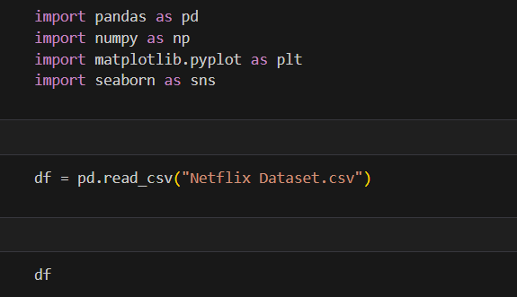
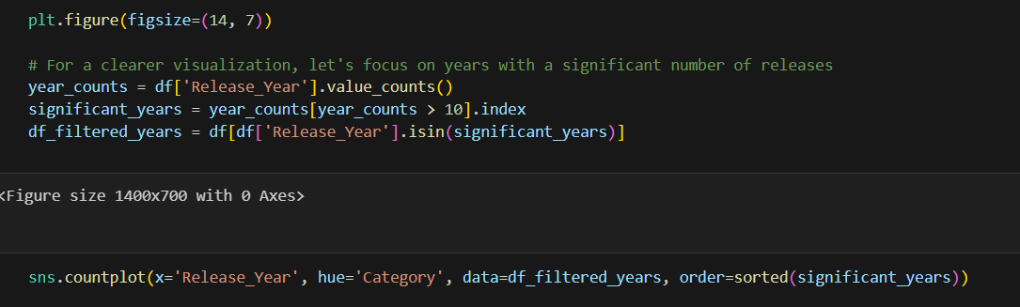

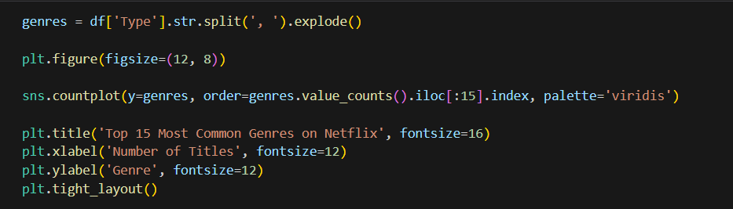

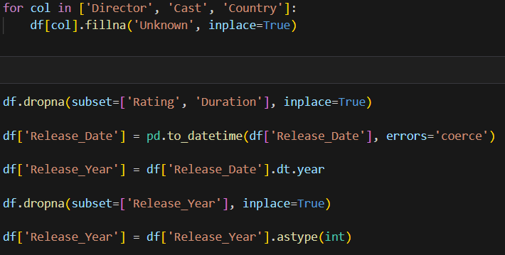
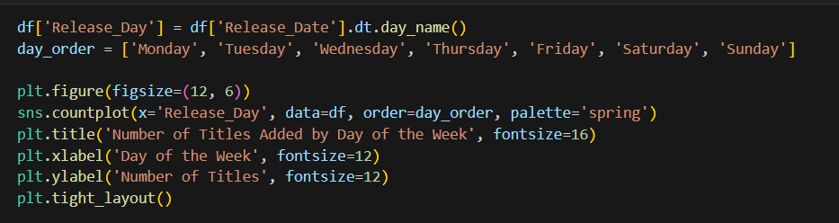
Python Code

Slide 7
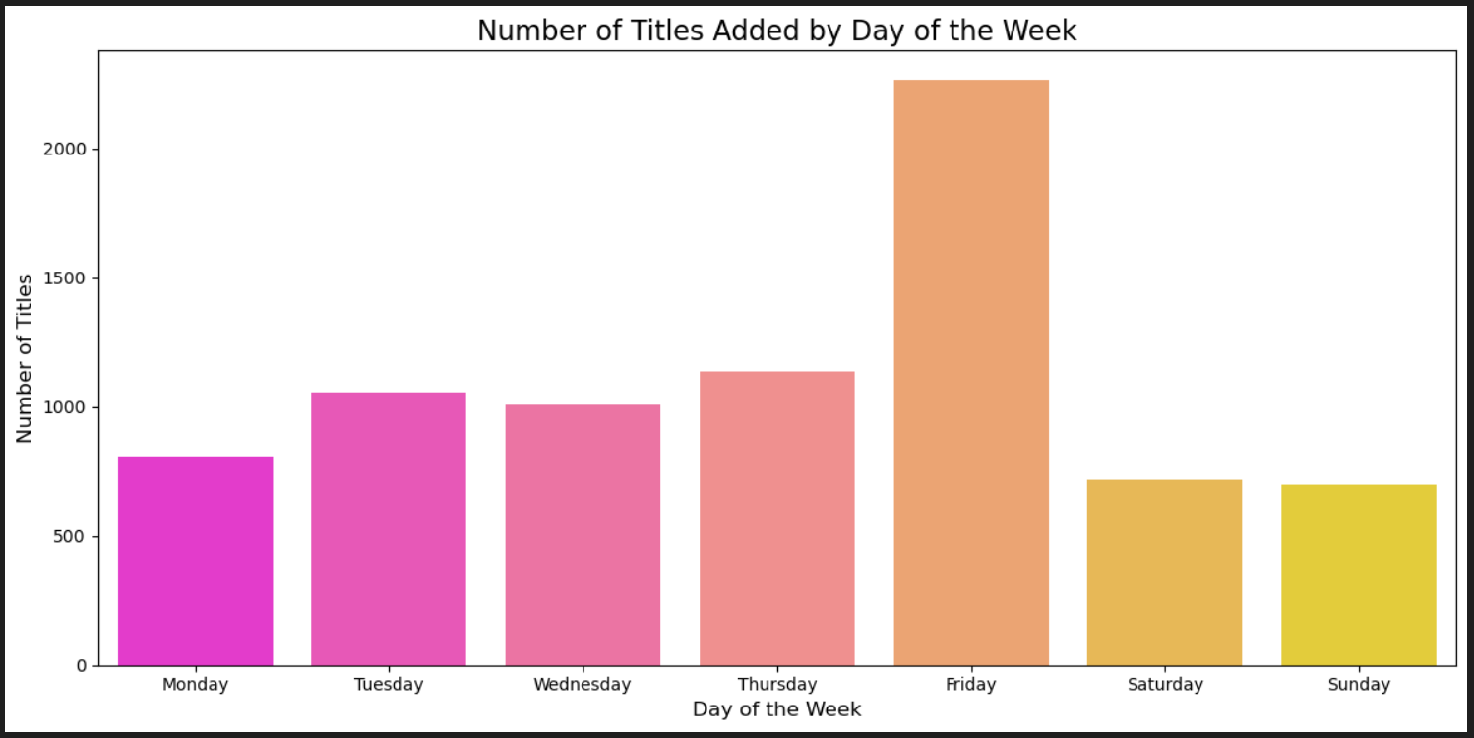
RESULTS1
[Add screen shots of your code or Chart(s) ]

Slide 8
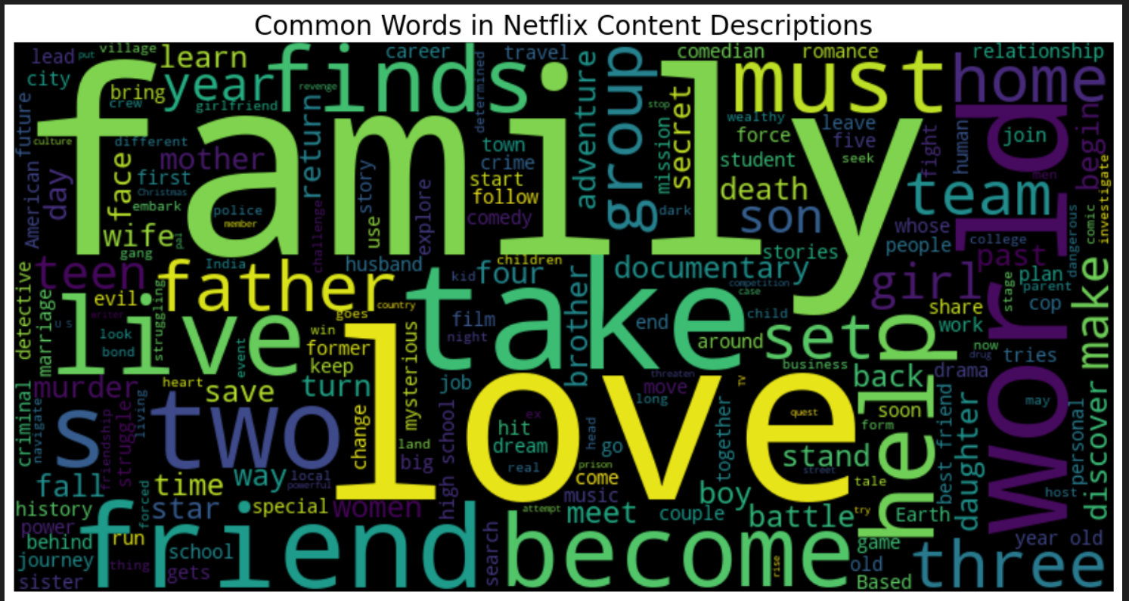
RESULTS2
[Add screen shots of your code or Chart(s) ]

Slide 9
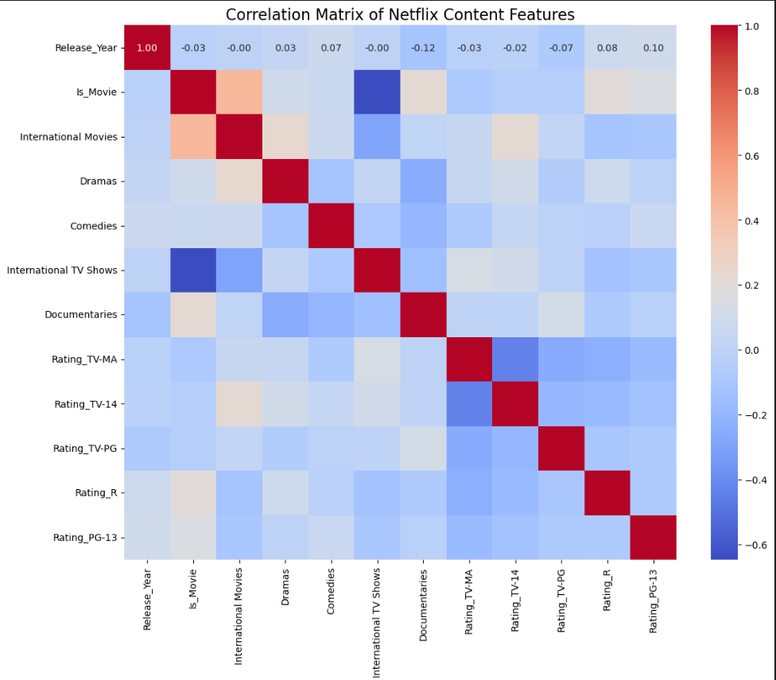
RESULTS3
[Add screen shots of your code or Chart(s) ]

Slide 10
GitHub repository
https://github.com/Adarsh0710/VOIS_AICTE_Oct2025_MajorProject_AdarshKumarSingh.git

Slide 11
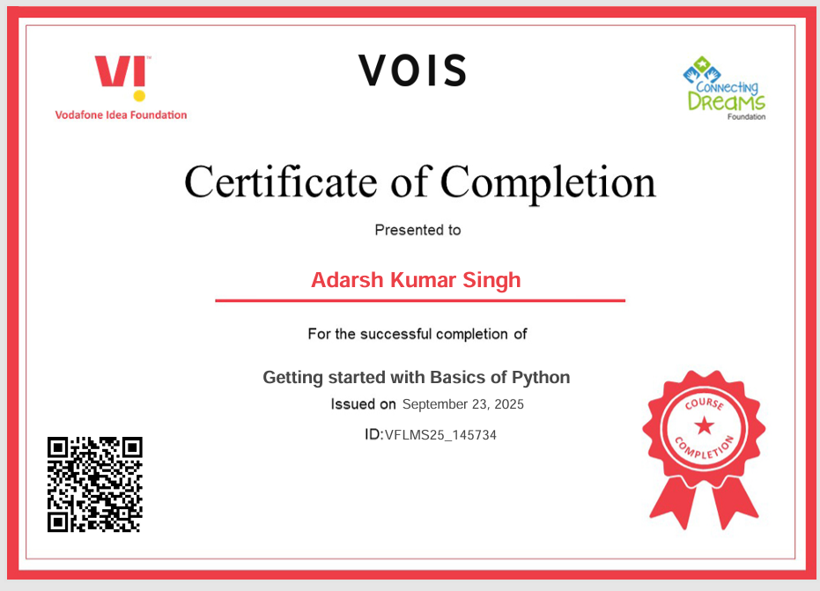
Getting started with Basics of Python Certificate
[Paste your Certificate Here]

Slide 12
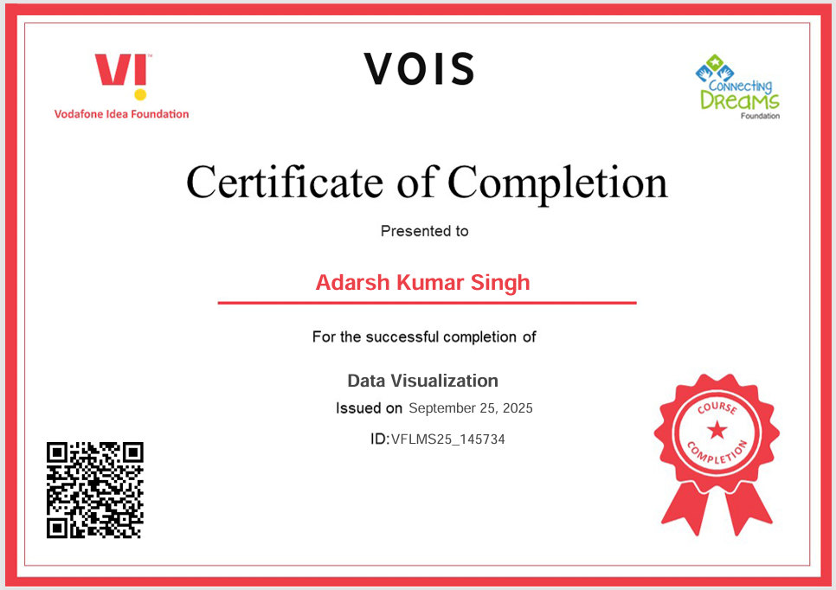
Data Visualization Certificate
[Paste your Certificate Here]

Slide 13
Thank you
.
.

